Slide 1
TWT AI MASTERY PROGRAM . CAPSTONE PROJECT · PROOF OF CONCEPT
AI Release Note Generation
Automating release notes with AI agents — while people stay in control
02 July 2026
Riffat Wyne

Slide 2




THE CHALLENGE
Why Release Notes Are Hard Today
Writers assemble release notes by hand from scattered engineering detail — it is slow, repetitive, and uneven in quality.
Manual Extraction
Repetitive Work
Slow Gathering
Uneven Quality
Work items and case numbers are pulled by hand from Azure DevOps and ServiceNow.
The same drafting and rewriting happens with every release, over and over.
Tracking down the right technical detail eats up a large share of each cycle.
Notes vary from release to release, and important technical detail often goes missing.
AI Release Note Generation · Capstone Project Riffat Wyne
2

Slide 3
THE APPROACH
A Human-in-the-Loop Proof of Concept
The goal is not to replace technical writers. It is to take the repetitive work off their plate while people stay responsible for review and publication.
What the AI does
What people keep
Collects and normalizes release data
Drafts clear, customer-friendly notes
Reviews its own draft for quality
Final review of every draft
Approval authority before publishing
Accountability for accuracy and tone
BUILT WITH
Claude Code
Cursor
GitHub
AI Agents
Skills
Prompts
Commands
AI Release Note Generation · Capstone Project Riffat Wyne
3

Slide 4






HOW IT WORKS
From Raw Tickets to a Published Note
Five stages move a release from scattered source data to a human-approved, published note.
Data Sources
AI Agents
Artifacts
Human Review
Publish
Azure DevOps & ServiceNow
Collect, analyze, write, review
JSON & Markdown outputs
Writer, SME, approval
Live in Document360
AI-performed step
Human-performed step
AI Release Note Generation · Capstone Project Riffat Wyne
4

Slide 5



THE BUILDING BLOCKS
Five Agents, One Job Each
Every agent does a single task. That keeps the workflow modular, easy to test, and simple to swap for live integrations later.
1
2
3
4
5
Collector
Analyzer
Writer
Reviewer
Draft Generator
Gathers the raw work items, bugs, and metadata for the release.
Sorts the changes, judges customer impact, and sets priority.
Turns the analysis into clear, customer-friendly release notes.
Checks the draft for quality, consistency, and completeness.
Applies the template and metadata to prepare the Document360 draft.
AI Release Note Generation · Capstone Project Riffat Wyne
5

Slide 6
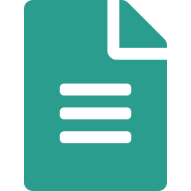
ARTIFACT FLOW
Each Agent Leaves a Traceable Output
Every step writes a file the next step reads — so any note can be traced back to the data it came from.
Collector
Analyzer
Writer
Reviewer
Draft Gen.
collected-release-data.json
analyzed-release.json
release-notes.md
review-report.md
document360-draft.md
Raw data
Analyzed data
Generated content
Quality report
Document360 draft
The AI never publishes. A person signs off every note.
Human review & approval
Technical Writer → SME → Approval → Publish
AI Release Note Generation · Capstone Project Riffat Wyne
6

Slide 7



HOW IT'S ORGANIZED
A Repository Built to Extend
Orchestration, prompting, reusable knowledge, and generated artifacts each live in their own place — so the solution stays easy to maintain and grow.
Orchestration
Reusable Knowledge
Source Data
Generated Artifacts
commands/ · prompts/
skills/
data/
output/
The reusable actions that drive each step of the workflow.
Style guides, templates, and checklists that shape how the AI drafts.
Mock Azure DevOps and ServiceNow inputs for the proof of concept.
Every AI and publishing artifact, kept separate for a clean audit trail.
AI Release Note Generation · Capstone Project Riffat Wyne
7

Slide 8




GOVERNANCE
AI Assists, People Decide
No draft reaches a customer without human sign-off. Every release passes through five review gates.
1
2
3
4
5
Technical Writer
SME Review
Documentation Approval
Publish
Notify
Reviews the draft, checks clarity and tone, edits and refines.
Validates technical accuracy, confirms feature detail and impact.
Final review, compliance and metadata checks, approval to publish.
Sends to the right category with tags, version, and audience set.
Informs internal teams and customers and shares release highlights.
Governance principle: AI prepares the content. People own quality and approval — every note is reviewed before it reaches a customer.
AI Release Note Generation · Capstone Project Riffat Wyne
8

Slide 9





CROSS-CUTTING CAPABILITIES
Safeguards Running Throughout
These capabilities apply across every stage — not just at the end — keeping the workflow safe, traceable, and ready to scale.
Logging & Audit
Version Control
Extensibility
Security & Compliance
Notifications
Every input and output is logged for full traceability.
All prompts, skills, and templates are versioned in GitHub.
Real systems connect later through MCP with no redesign.
Data privacy and access control are enforced throughout.
Alerts for reviews, approvals, and publication (future).
AI Release Note Generation · Capstone Project Riffat Wyne
9

Slide 10
LOOKING AHEAD
Only the Data Source Changes
Because the workflow is modular, swapping mock data for live systems needs no redesign — the same five agents keep running.
TODAY — PROOF OF CONCEPT
FUTURE — LIVE SYSTEMS VIA MCP
Mock Azure DevOps data
Mock ServiceNow data
Local release-note template
Live Azure DevOps (MCP)
Live ServiceNow (MCP)
Document360 (MCP)
Same five AI agents · no change to agent logic or workflow
AI Release Note Generation · Capstone Project Riffat Wyne
10

Slide 11



ROADMAP
Watch the demo video
From Proof of Concept to Practice
NOW
NEXT
LATER
Phase 1 — Completed
Phase 2 — Integrations
Phase 3 — Enterprise
Proof of concept with five working agents, skills, prompts, and commands.
Azure DevOps, ServiceNow, and Document360 via MCP, plus GitHub Actions.
Scheduled releases, automated draft creation, and notification workflows.
AI Release Note Generation · Capstone Project Riffat Wyne
11

Slide 12
“This makes people faster,
not redundant.”
High-quality, customer-facing release notes — generated with AI efficiency and delivered under human oversight.
PROOF OF CONCEPT · CAPSTONE PROJECT
Riffat Wyne
Thank you

Slide 13
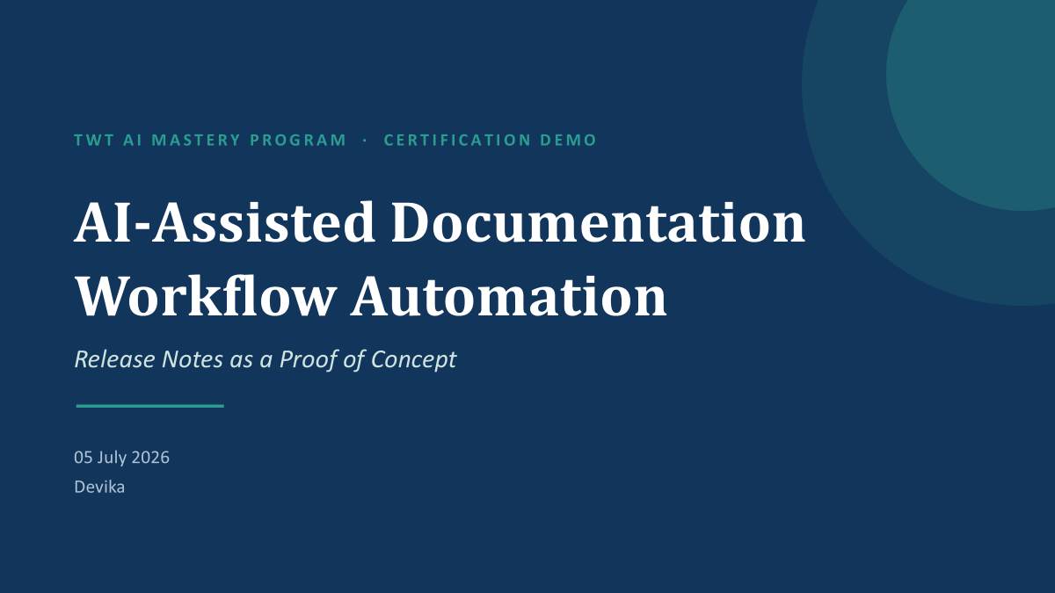
TWT AI MASTERY PROGRAM · CERTIFICATION DEMO
AI-Assisted Documentation
Workflow Automation
Release Notes as a Proof of Concept
05 July 2026
Devika
Notes:
Welcome the audience and frame the session: this is the certification demo for the Release Note Workflow Automation proof of concept, built as part of the TWT AI Mastery program. Open by naming the team briefly and thanking the trainer and the course. Set expectations: this is a proof of concept, not a production system, and the goal today is to show how AI capabilities — Commands, Skills, Agents, and MCP integrations — can meaningfully improve release note creation while keeping a human in control at every step. Preview the three parts of the walkthrough: the problem and design, a live demonstration of two scenarios, and the responsible-AI validation and roadmap. Keep this slide brief — under 30 seconds — energy and clarity matter more than detail here.

Slide 14




SECTION 1 · CONTEXT & FOUNDATION
Solution Architecture: Four AI Building Blocks
Each capability plays a distinct role in the workflow — together they automate drafting while preserving oversight.
Commands
Skills
Agents
MCP Integrations
Reusable prompts that trigger a consistent drafting or review action on demand.
Packaged expertise — style guides and templates — that shape how AI drafts.
Multi-step helpers that extract, draft, and self-review before human handoff.
Connectors to YouTrack and GitHub for direct, automated data retrieval.
AI-Assisted Documentation Workflow Automation
5
Notes:
Introduce the four AI capabilities this PoC demonstrates, left to right. Commands are the reusable prompts the writer triggers — think of them as on-demand actions. Skills package expertise, like the release-note style guide, so drafts come out consistent regardless of who runs the command. Agents are the multi-step workers: they extract from tickets, draft, and run a self-review pass before anything reaches a human. MCP integrations are the forward-looking piece — direct connectors into YouTrack and GitHub — and we'll flag that this is a roadmap item today, demonstrated conceptually rather than fully wired end-to-end. Bridge: 'Here's how those four pieces combine into a full future-state workflow.'

Slide 15



SECTION 1 · CONTEXT & FOUNDATION
Future-State Workflow: AI-Assisted, Human-Approved
Issues
retrieved
AI extracts
& drafts
AI self-
reviews
Human
approves
Publish
AI-performed step
Human-performed step
~80–90%
estimated reduction in end-to-end cycle time versus the current 9–15 day manual process, per the future-state workflow analysis
AI-Assisted Documentation Workflow Automation
6
Notes:
Walk the same five-stage shape as the current-state slide, but color-code who does each step: teal for AI-performed steps, navy for human-performed steps. AI retrieves and reads issues, extracts and drafts the note, and runs a self-review pass — three consecutive AI steps. Then the flow deliberately hands off: a human approves, and only a human publishes. That handoff is not incidental, it is the design. Cite the estimated 80-90% cycle time reduction from the future-state workflow document as directional, not audited — call it an estimate, not a guarantee. Bridge: 'Let's stop talking about the design and actually see it work — two scenarios.'

Slide 16


SECTION 2 · DEMONSTRATION
Two Scenarios, One Governance Principle
Both scenarios run the same AI workflow — they differ only in what happens when engineering information is incomplete.
Scenario 1: Feature Release
Scenario 2: Mixed Release
Complete engineering information in YouTrack
AI drafts a complete, publish-ready note
Demonstrates the automation gain
Incomplete engineering information
AI flags the gaps instead of inventing content
Demonstrates the responsible-AI safeguard
AI-Assisted Documentation Workflow Automation
7
Notes:
Frame the live demo before running it. We'll show two scenarios using the same underlying agent workflow. Scenario 1, Feature Release, has complete engineering detail in YouTrack, so the AI produces a full, publish-ready draft — this shows the raw automation gain. Scenario 2, Mixed Release, deliberately has incomplete information, so the AI flags the specific gaps rather than guessing or fabricating — this shows the safeguard that makes the workflow trustworthy. Tell the audience which one you'll run live and which one you'll walk through as a pre-built artifact, per your demo plan, so expectations are set before you switch screens.

Slide 17




SECTION 2 · DEMONSTRATION
Scenario 1: Feature Release Walkthrough
Complete ticket information flows straight through to a human-approved draft.
1. Extract
2. Draft
3. Self-Review
4. Human Approval
Agent reads the YouTrack issue: title, description, and resolution notes.
Skill applies the release-note style guide to produce a structured draft.
Agent checks its own draft against the source ticket for accuracy.
Writer reviews, edits if needed, and gives the final sign-off.
AI-Assisted Documentation Workflow Automation
8
Notes:
Narrate live as you run this scenario: the agent extracts directly from the YouTrack issue — title, description, resolution notes — then a skill applies the release-note style guide to draft it in the house voice. Before handing off, the agent runs a self-review pass, checking its own draft against the source ticket for accuracy. Then stop and hand control to the human reviewer step explicitly: the writer reads the draft, makes any edits, and gives the final sign-off. Reinforce: 'Notice the AI did not publish anything — it produced a draft for a human to approve.'

Slide 18
SECTION 2 · DEMONSTRATION
Scenario 1 Result: Before & After
BEFORE — Raw Ticket Fragments
AFTER — Human-Approved Draft
YT-4021: bulk export button, CSV only, added retry logic
Status: Resolved, no customer-facing summary written
Component: Reporting module
Resolution note: “fixed timeout on large exports”
Bulk Export Improvements
You can now export large reports to CSV more reliably. We fixed a timeout issue that affected bulk exports and added automatic retry logic to reduce failed downloads.
Component: Reporting
AI-Assisted Documentation Workflow Automation
9
Notes:
Show the transformation concretely. On the left is what a writer starts with today — raw ticket fragments, technical shorthand, no customer framing. This example is illustrative, built to represent a typical ticket, not a real customer issue. On the right is the AI-produced draft after the writer's review: customer-facing language, a clear headline, and plain-English impact. Note that every fact in the 'after' text traces back to something in the 'before' — nothing was invented. That traceability is exactly what the AI-assisted framing promises. This is the automation win: minutes instead of days for the first draft, with a human still finishing the job.

Slide 19
SECTION 2 · DEMONSTRATION
Scenario 2: Mixed Release Walkthrough
When information is incomplete, the AI flags the gap instead of guessing.
1. Extract
2. Gap Check
3. Flag, Don't Fabricate
4. Human Follow-Up
Agent reads the ticket — this one is missing a customer impact statement.
Agent compares available fields against what the style guide requires.
Agent stops and surfaces exactly what is missing, with no invented content.
Writer supplies the missing detail; only then does drafting continue.
AI-Assisted Documentation Workflow Automation
10
Notes:
This is the scenario that carries the responsible-AI message, so narrate it deliberately. The agent extracts from a ticket that is missing a customer impact statement — a required field per the style guide. Instead of inferring or inventing that detail, the agent stops at the gap-check step and surfaces precisely what's missing. Say the key phrase here explicitly: 'AI only uses provided information.' It does not guess to fill the silence. The workflow then routes back to the human, who supplies the missing detail before drafting resumes — the human is a required input, not an optional check.

Slide 20



SECTION 2 · DEMONSTRATION
Scenario 2 Result: The Gap-Flag in Action
Gap Detected — Cannot Complete Draft
Missing: customer impact statement for YT-4108 (Reporting module). Please provide before I continue drafting.
No content is invented to fill the silence
Draft pauses and routes back to the writer
Resumes only once the human supplies the fact
AI-Assisted Documentation Workflow Automation
11
Notes:
Point to the flagged message on screen and read it aloud — it's specific about which ticket and exactly which field is missing, not a vague error. Walk the three outcomes underneath: nothing is invented to fill the silence, the draft pauses and routes back to the human, and it only resumes once the missing fact is supplied. This is the moment to land the second key phrase: 'humans make final approval' pairs with this gap-flag behavior — the human isn't just approving at the end, they're a required input whenever information is genuinely missing. Bridge: 'That behavior isn't incidental — it's a deliberate governance principle. Let's look at how we validated it.'

Slide 21
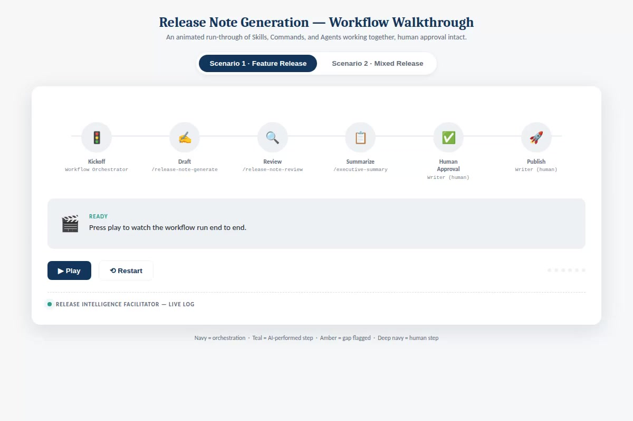
SECTION 2 · DEMONSTRATION
Watch It Run: Both Scenarios End to End
A recorded run of the interactive workflow walkthrough — Feature Release, then Mixed Release.
AI-Assisted Documentation Workflow Automation
12

Slide 22


SECTION 3 · VALIDATION & ROADMAP
Responsible AI: Four Governance Principles
Every principle traces back to one idea: AI assists, humans decide.
Final Approval is Human
No Fabrication
Transparent Reasoning
Auditable Trail
No draft reaches customers without explicit sign-off from a person.
When information is missing, the AI flags it — it never invents detail.
Every AI output can be traced back to the source ticket it drew from.
Each draft, edit, and approval is logged for review after the fact.
AI-Assisted Documentation Workflow Automation
13
Notes:
Move from the live demo to how we govern this pattern more broadly. Four principles, all downstream of the same idea. Final approval is always human — nothing ships without a person's sign-off. No fabrication — you just watched this in scenario 2, where the AI flagged rather than guessed. Transparent reasoning means every line in an AI draft can be traced to a specific ticket, which is what makes the traceability problem from slide 2 actually solved, not just hidden. Auditable trail means every draft, edit, and approval is logged, so if something goes wrong after publish, the review path is reconstructable. These four principles are what the validation work in the next slide was designed to test.

Slide 23
SECTION 3 · VALIDATION & ROADMAP
What This Proof of Concept Validated
End-to-end workflow automation, ticket to draft
Human review checkpoint enforced at every run
AI-assisted information extraction from YouTrack
Gap-flagging instead of fabrication on incomplete data
Release note generation via Commands and Skills
Documented known limitations and open questions
AI self-review and quality checks before handoff
Concept-level MCP integration path identified
AI-Assisted Documentation Workflow Automation
14
Notes:
This slide is the checklist against the project charter's success criteria — read it as evidence, not aspiration, since everything here was actually demonstrated today. Call out that the MCP integration path is validated at the concept level only; full automated retrieval from YouTrack and GitHub is future work, addressed on the roadmap slide next. If asked by evaluators, be ready to point to the specific validation findings and known-limitations documentation Anubhav's team maintained, since this slide summarizes rather than replaces that record. Bridge: 'With validation covered, here's where the next iteration goes.'

Slide 24


SECTION 3 · VALIDATION & ROADMAP
Roadmap: From Proof of Concept to Practice
NOW
NEXT
LATER
Proof of Concept
MCP Integration
Scale & Extend
Two validated scenarios; Commands, Skills, and Agent patterns demonstrated in Claude.ai.
Direct connectors to YouTrack and GitHub for automated draft retrieval, removing manual data pulls.
Apply the same AI-assisted pattern to other documentation types beyond release notes.
AI-Assisted Documentation Workflow Automation
15
Notes:
Three horizons, deliberately scoped so nobody thinks this PoC claims more than it delivers. Now: what you saw today — two validated scenarios using Commands, Skills, and Agents inside Claude.ai. Next: MCP integration with YouTrack and GitHub, so draft retrieval becomes automated rather than manually pasted in — this is the most requested next step from the team. Later: once the pattern is proven for release notes, the same AI-assisted approach could extend to other documentation types, though that is explicitly out of scope for this proof of concept. Keep this slide honest about sequencing — avoid implying MCP integration is already built.

Slide 25
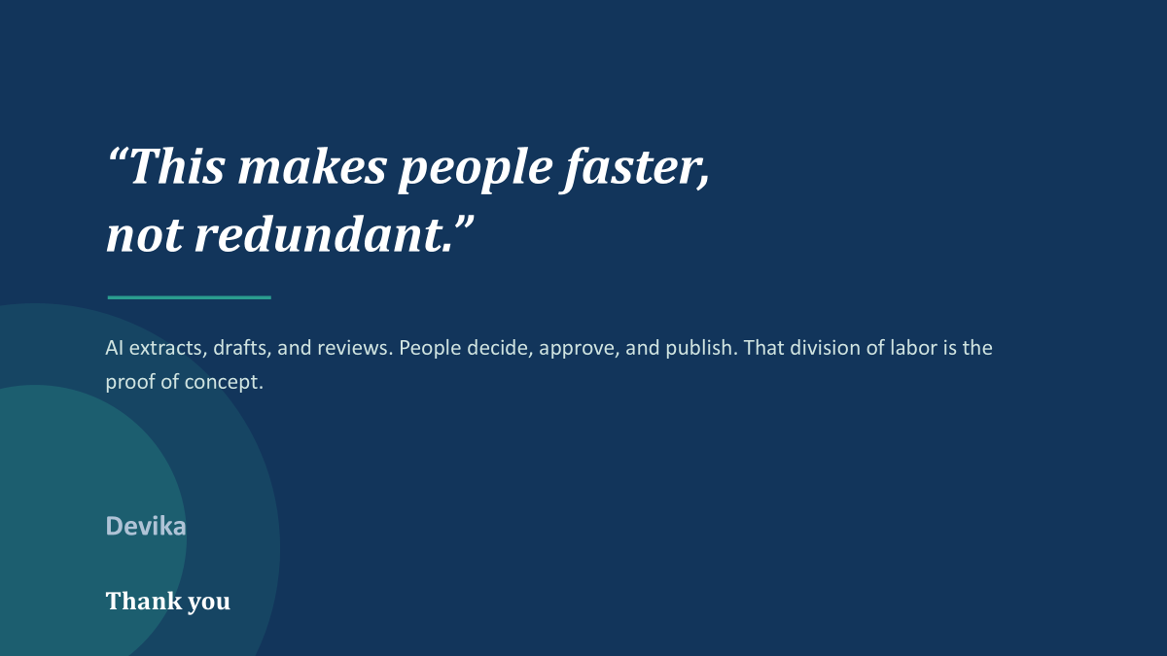
“This makes people faster,
not redundant.”
AI extracts, drafts, and reviews. People decide, approve, and publish. That division of labor is the proof of concept.
With thanks to the project team
Riffat Wyne · Sulekha · Anubhav · Srividya · Bhargavi · Shubh Karman · Divin · Devika
Thank you
Notes:
Close on the human-effectiveness message, not a technology flex. Read the quote and let it land: this makes people faster, not redundant. Restate the division of labor in one breath — AI extracts, drafts, and reviews; people decide, approve, and publish — that's the entire proof of concept in a sentence. Thank the team by name, since this was a group effort across workflow design, validation, and prototyping. Open the floor for questions, and if evaluators probe on production-readiness, be direct that this is explicitly a proof of concept: the MCP integration, broader document types, and full audit tooling are roadmap items, not built today.

Slide 26
TWT AI MASTERY PROGRAM . CAPSTONE PROJECT · PROOF OF CONCEPT
AI Powered Release Note Workflow
Transforming Source Data into Publication-Ready Documentation
05 July 2026
Bhargavi

Slide 27



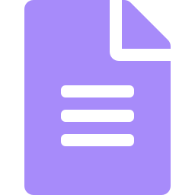

01 CONTEXT
Business Challenge
Fragmented Sources
Manual & Time-Consuming
Release information is scattered across multiple source systems and implementation notes.
Manual release notes creation is repetitive and time-consuming
Heavy Review Loops
Publication Overhead
Multiple review passes multiply the documentation effort per release.
Extra manual formatting is needed to make notes publication-ready.
OBJECTIVE Automate the end-to-end release-note workflow while ensuring quality, consistency, and publication standards.
02

Slide 28





02 APPROACH
AI-Powered Solution
Source Data +
Impl. Notes
Release Data
Extractor
Release Note
Generator
Publication-Ready
Release Note
Release Note
Publisher
Release Note
Reviewer
AI SKILLS
Release Data Extractor
Release Note Generator
Release Note Reviewer
Release Note Publisher
Human Review and Approval
03

Slide 29


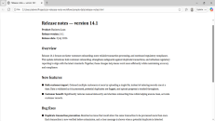

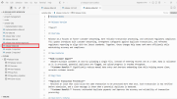

03 DEMONSTRATION
End-to-End Workflow
01
02
03
Extract Source Data
Generate Release Note
Review Release Note
04
Publish Release Note
Human Validation -> Approval -> Publication
04

Slide 30
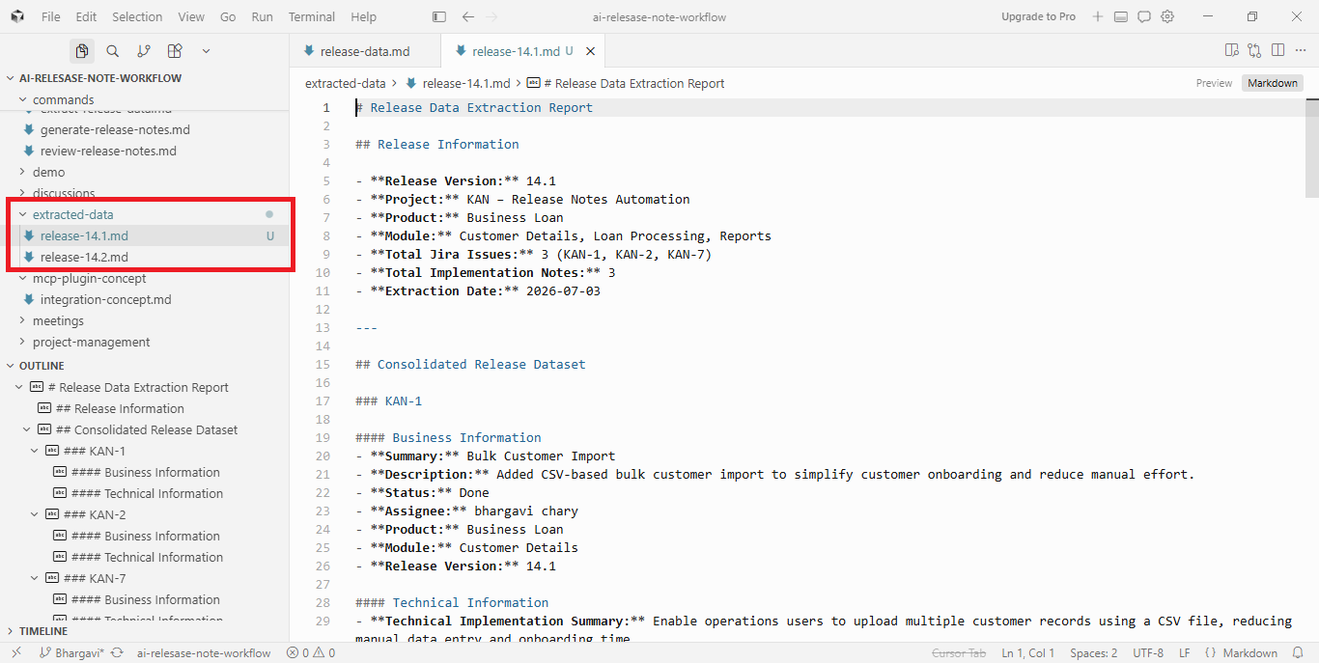

Slide 31
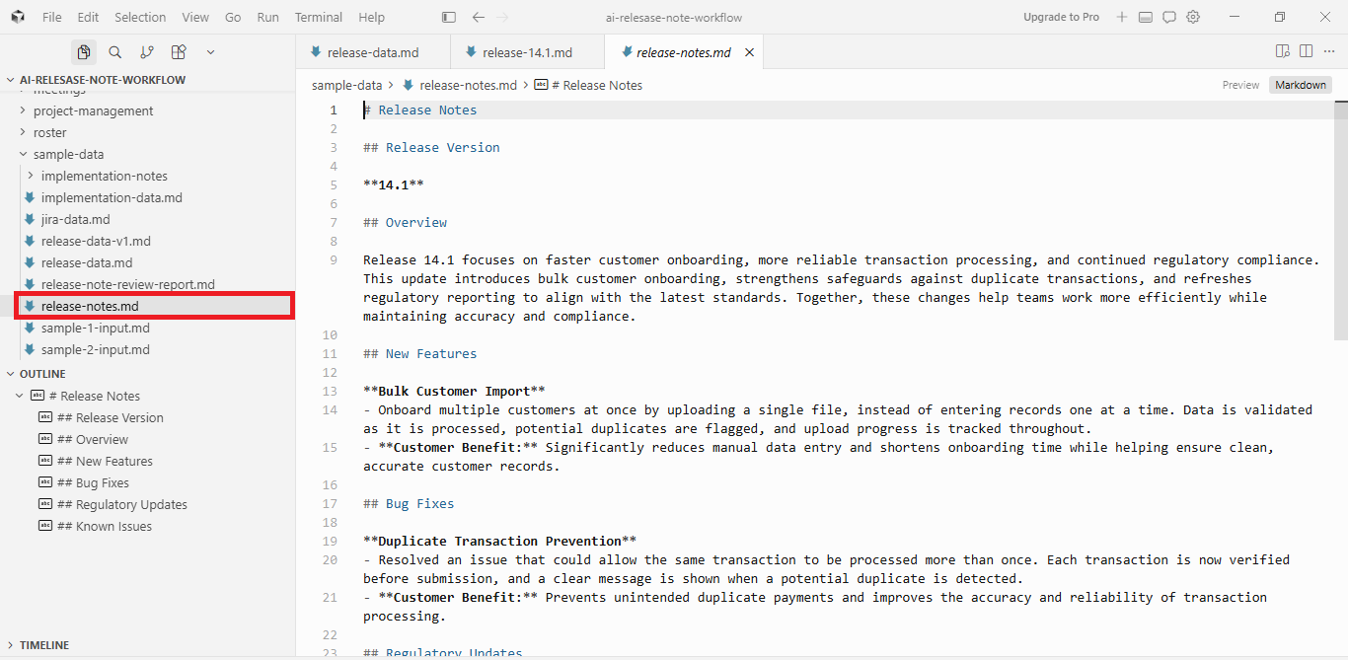

Slide 32
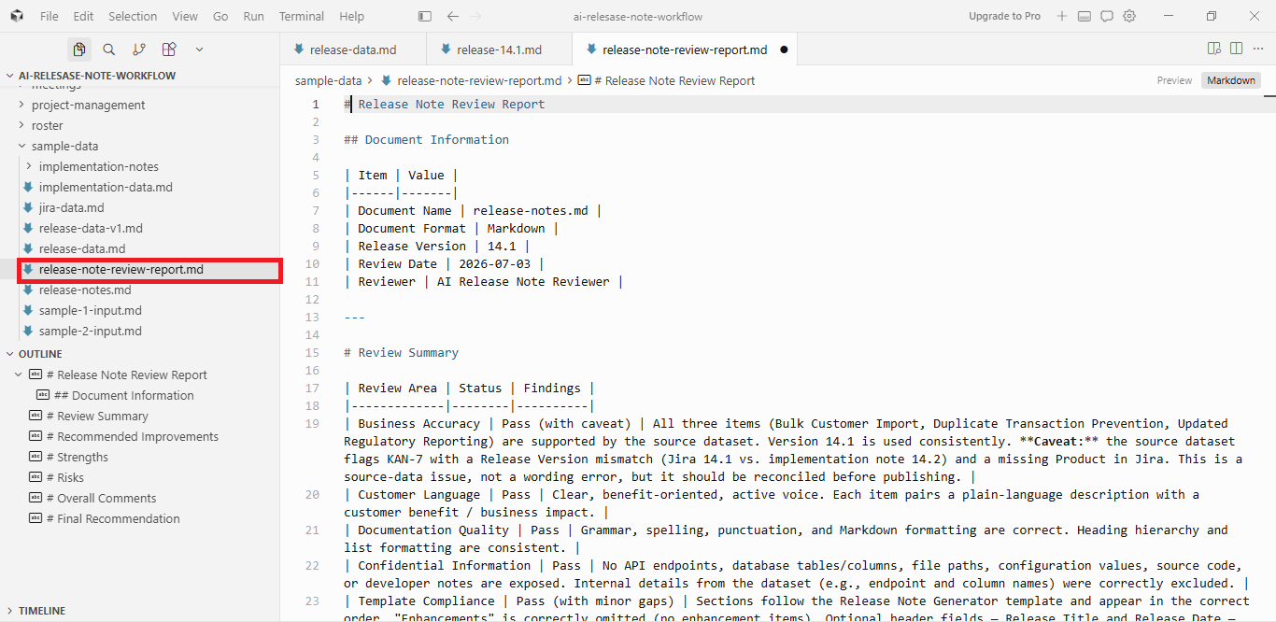

Slide 33
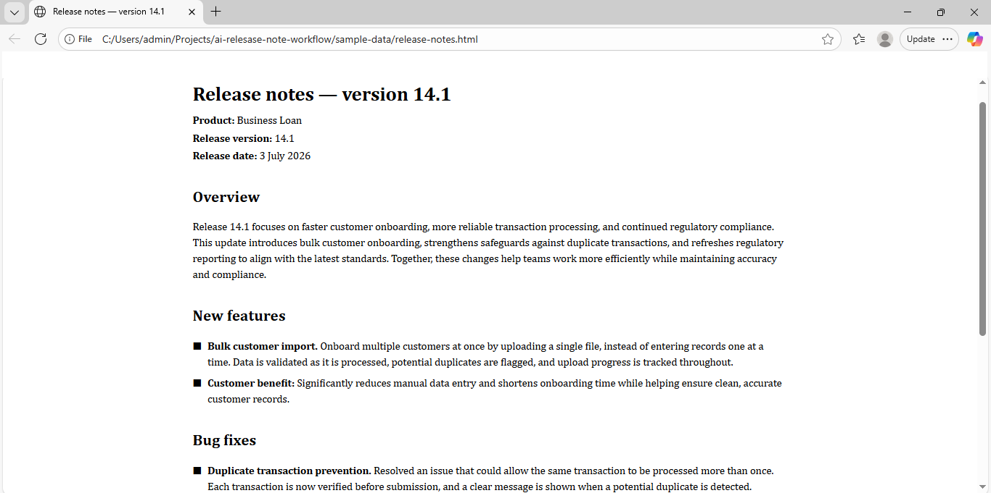

Slide 34





04 IMPACT
Business Value
Benefits
Reduced manual documentation effort in release note creation
Consistent and standardized release note generation
Faster documentation turnaround
Publication-ready outputs
Improved content quality through AI review
05

Slide 35
